Slide 1






Forecasting Zestimate Error for Zillow: A Data Analysis IFN701 Project
Zillow: A leading real estate agent in U.S.
Zestimate: Zillow’s home value estimation model
logerror = log(Zestimate) – log(SalePrice)
Student: Linni QIN (n9632981)
Supervisor: Dr Guido Zuccon
Constrains
& Risks Management
Scopes
Deliverables
Motivation
Significance
Methodologies
Pictures from https://www.google.com.au/search?q=real+estate&source=lnms&tbm=isch&sa=X&ved=0ahUKEwimtIbS6M3VAhUMVbwKHaf-DhwQ_AUICygC&biw=1920&bih=963

Slide 2


Project Scopes & Deliverables
Zillow Scopes: → Improve Zestimate model → Predict Zestimate errors for 6 timepoints: Oct. Nov. and Dec. of 2016, Oct. Nov. and Dec. of 2017 → Practice on the training data through 2016 3millions of properties in 3 counties in California, USA (LA, OR, VE) 57 variable physical data/ property (eg. room number, location) Test data of 2017 will be available on October2, 2017 Zillow Deliverables: CSV file, R markdown file
QUT Scopes & Deliverables → IFN701: Project Proposal, Project Presentations and Final project report

Slide 3
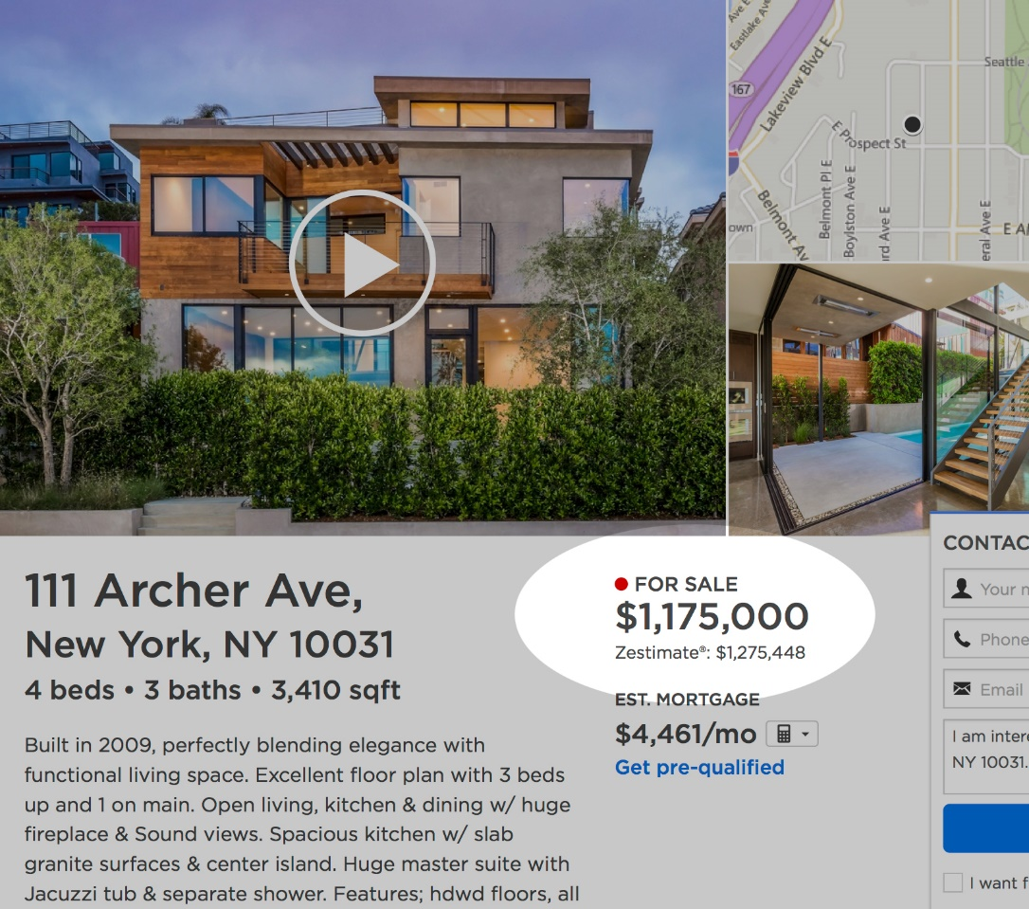
Project Motivation & Anticipated Significance
Motivation → Application of my educational skills → Pursuit of financial data analysis
Anticipated Significance → 2006 – 2017 Zestimate Median Error Rate 14% ➔ 5% → Median Error means 50% home value estimation ≈ 5% another 50% prediction > 5% → A trusted platform to monitor home asset
Picture & Data from https://www.kaggle.com/c/zillow-prize-1 & https://www.zillow.com/zestimate/

Slide 4
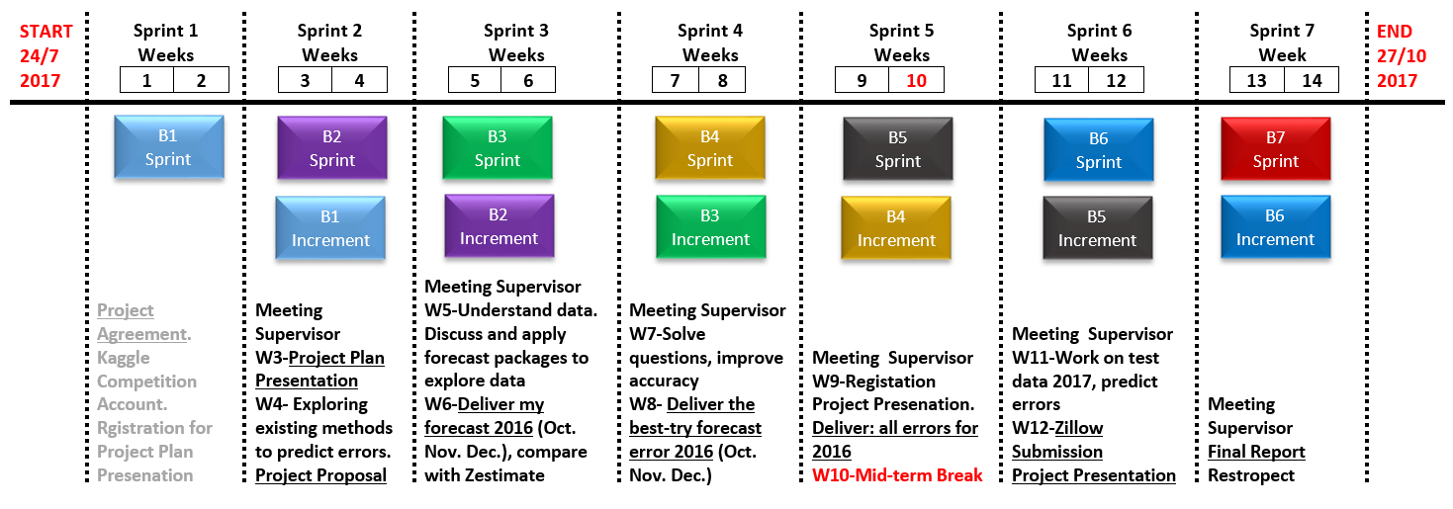
Methodologies for Project
Project Categories: A Development Project
Project Management Approach: Scrum Complex products and complex environment
Two-week Sprints

Slide 5

Constrains & Risk Management
Constrains (1) | Mitigation
Two final submission for Zillow only | Think and check carefully before submission
Risks (3) | Mitigation
Unavailable Supervisor | Alternative communication channels (Slack, Other group students)
Loss of the work | Stable backup (GitHub)
Limited computing power of private Laptop or University computer | Discuss solutions with supervisor to find more powerful resources

